Slide 1

Serverless Audio/Video Chatbot
Abhishek Bhamidipati

Slide 2
Table of Contents
Introduction
Architecture Overview
Audio Upload Endpoint
Whisper Integration
OpenAI endpoint
Prompt Engineering
Chatbot UI Integration
Testing
Deployment
Improvements

Slide 3
Introduction
Purpose
Goal
This project simplifies learning by letting students upload lecture audios/videos and chat about them. Using OpenAI's Whisper, the project turns these files into searchable knowledge bases, making learning seamless and accessible.
The presentation aims to demonstrate how Generative AI enhances learning. Through features like audio/video uploads and chat interfaces, coupled with Whisper's transcription, the project inspires educators and students to embrace innovative learning methods.

Slide 4
ARCHITECTURE OVERVIEW

Slide 5






Whisper
Users
API Gateway
S3 Bucket
Upload files
Raw audio/ video files
AWS Secrets Manager
Users
API Gateway
AWS Lambda
Enter query
Transcribed files
GPT-4

Slide 6
REST API Endpoints Design
AWS API Gateway
Authentication and Authorization
Full lifecycle management of APIs, built-in authorization and authentication mechanisms (IAM, Cognito), support for API versioning and usage plans.
Use AWS IAM for fine-grained access control, role-based access control (RBAC) for defining access policies.
Endpoint Design
Security Considerations
Follow RESTful principles for designing API endpoints (resource-based URLs, HTTP methods for CRUD operations, stateless communication).
Implement HTTPS encryption, input validation, and output encoding to prevent security vulnerabilities (SQL injection, XSS attacks)

Slide 7
AUDIO UPLOAD ENDPOINT

Slide 8
Whisper
Transcribe
Users
API Gateway
S3 Bucket
S3 Bucket
Upload files
Raw audio/ video files
Transcribed files
Fetch API Key
AWS Secrets Manager

Slide 9
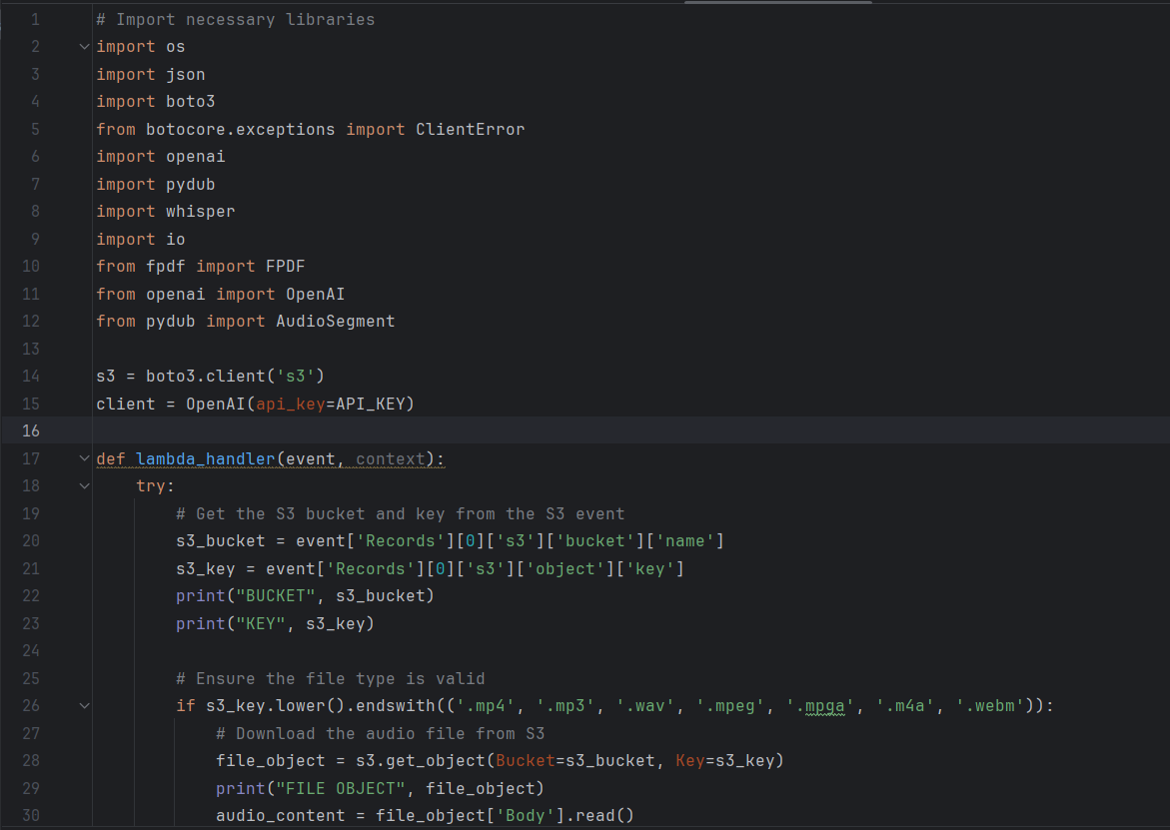

Slide 10
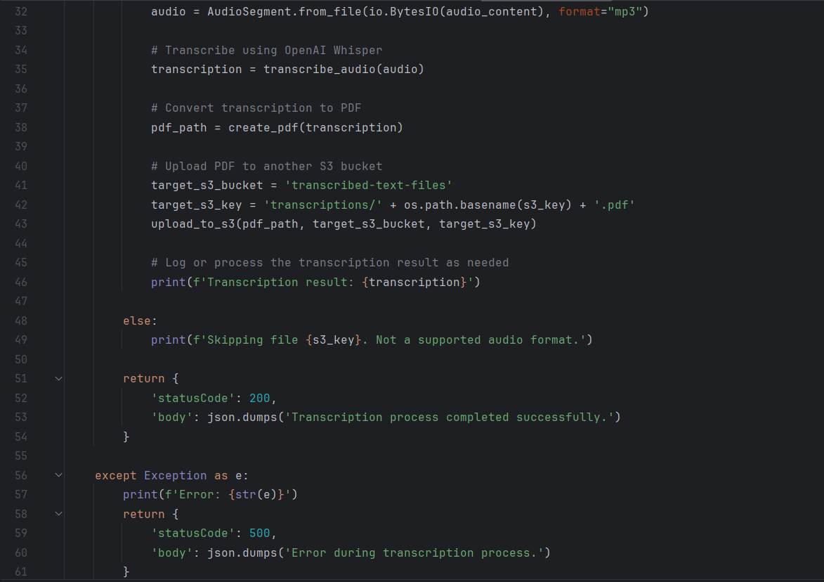

Slide 11
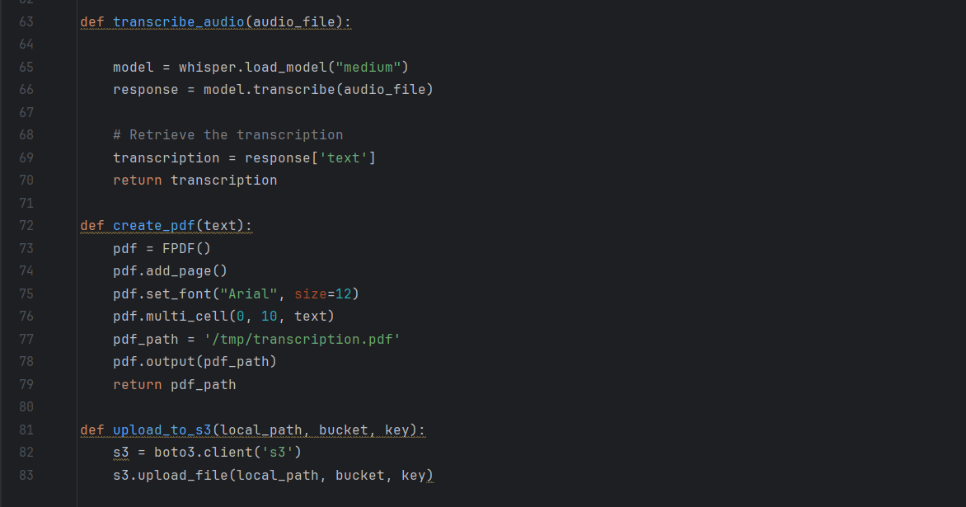

Slide 12
OpenAI WHISPER

Slide 13

OpenAI Whisper
Whisper is an open-source ASR library released by OpenAI in September 2022. Whisper takes an audio or audiovisual file as input and returns a transcription of the audio as output. This transcription can be saved as a plain text file, or as a subtitle file with time code data.
Supported formats: mp4, mp3, mpeg, mpga, m4a, wav, and webm

Slide 14
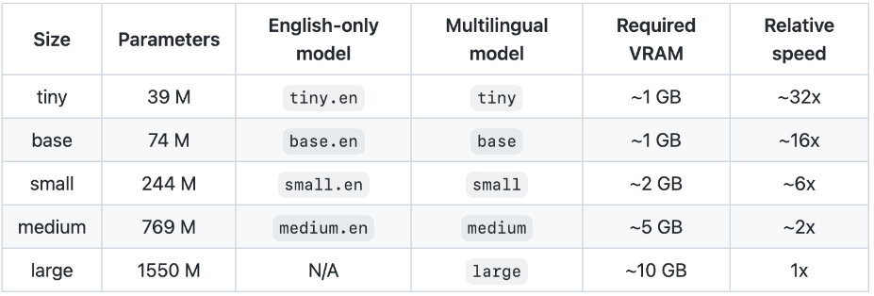
OpenAI Whisper
Approximate processing time on a 40-minute video using medium.en:
- About 6 minutes on GPU
- About 1.5 hours on CPU

Slide 15
Limitations of Whisper
Hallucinations
Lower accuracy on non-English audio
Maximum file size of 25 Mb

Slide 16
OpenAI LLM ENDPOINT

Slide 17
GPT-4
Send transcription and user query
Users
API Gateway
S3 Bucket
LLM Response
User Query
Transcribed files
Fetch API Key
AWS Secrets Manager

Slide 18
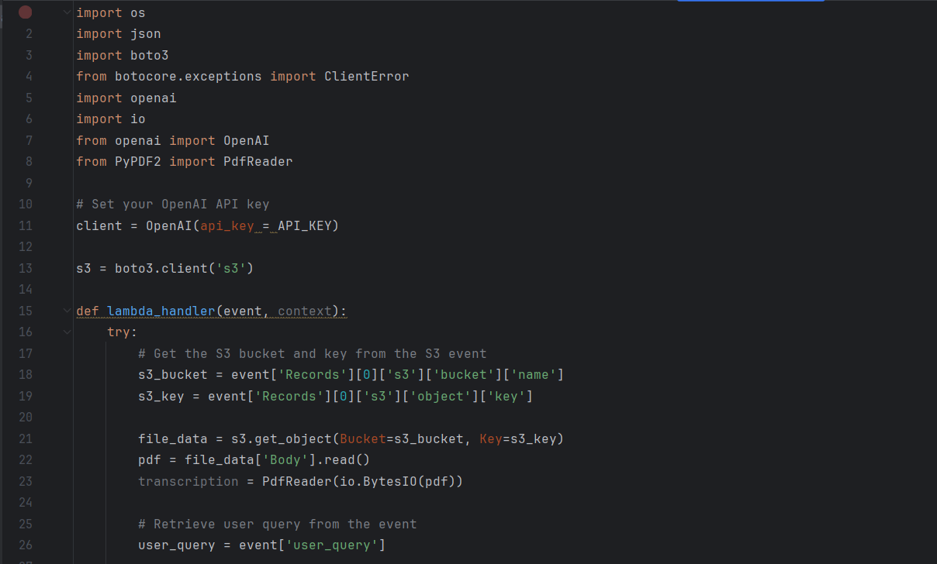

Slide 19
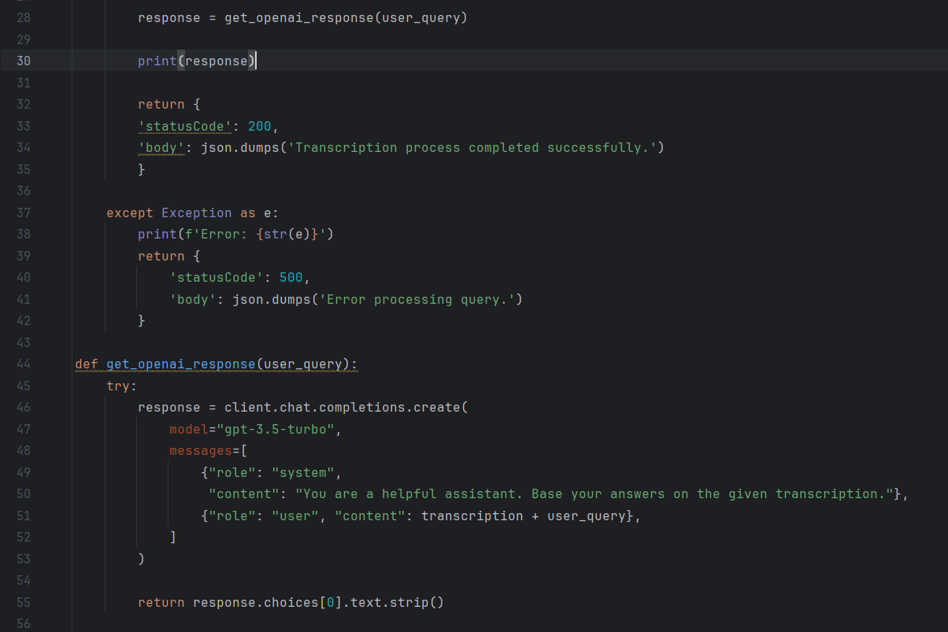

Slide 20
PROMPT ENGINEERING

Slide 21
Prompt Engineering for Whisper
Prompts can be very helpful for correcting specific words or acronyms that the model may misrecognize in the audio. For example, the following prompt improves the transcription of the words DALL·E and GPT-3, which were previously written as "GDP 3" and "DALI": "The transcript is about OpenAI which makes technology like DALL·E, GPT-3, and ChatGPT with the hope of one day building an AGI system that benefits all of humanity"
The first method involves using the optional prompt parameter to pass a dictionary of the correct spellings.
transcribe(filepath, prompt="ZyntriQix, Digique Plus, CynapseFive, VortiQore V8, EchoNix Array, OrbitalLink Seven, DigiFractal Matrix, PULSE, RAPT, B.R.I.C.K., Q.U.A.R.T.Z., F.L.I.N.T.")

Slide 22
Prompt Engineering for Chatbot
Prompting Techniques:Explore various prompting strategies (contextual, structured, conversational) to optimize user interactions and improve assistant response accuracy.
Prompt Evaluation:Establish evaluation criteria (engagement, relevance, clarity) for assessing prompt effectiveness and iteratively refine prompts based on user feedback and performance metrics.

Slide 23
CHATBOT UI INTEGRATION

Slide 25
TESTING

Slide 26
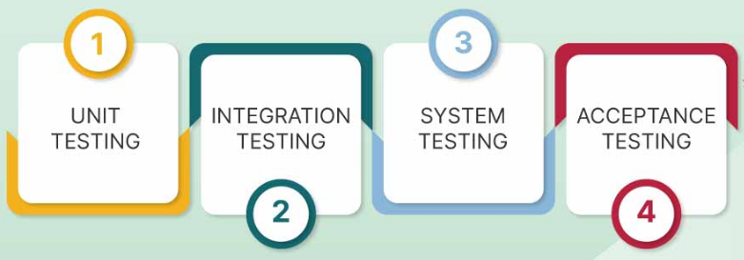
Types of Testing

Slide 27
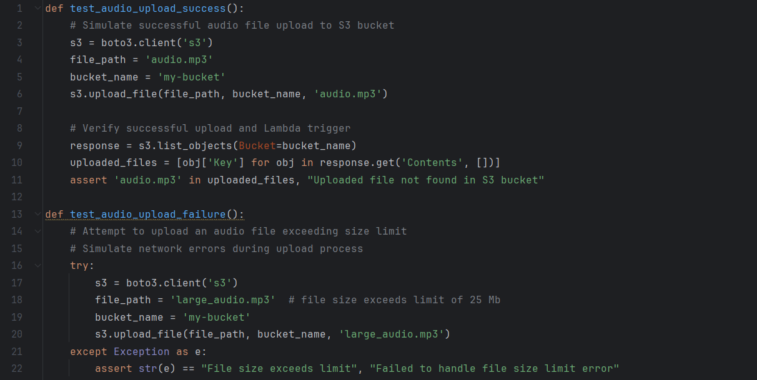

Slide 28
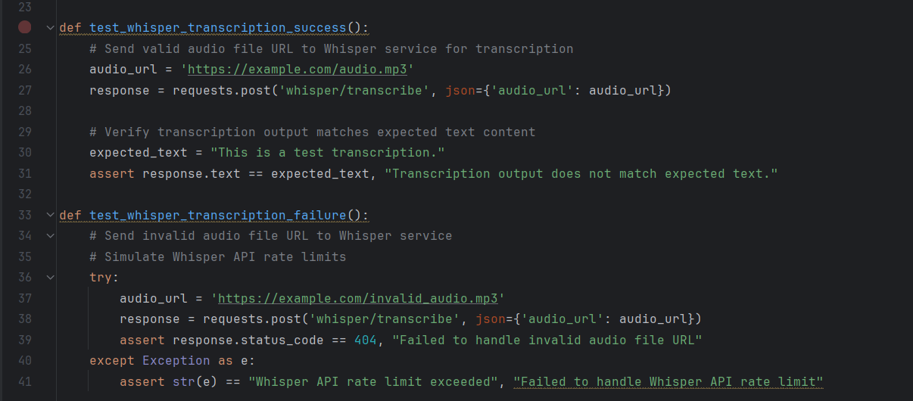

Slide 29
DEPLOYMENT

Slide 30
Serverless Framework
Abstraction of infrastructure
Serverless Framework is an open-source framework for building and deploying serverless applications
It abstracts away the complexity of managing infrastructure and allows developers to focus on writing code
Support of multiple cloud providers
Easy configuration

Slide 31
Steps to Deploy
Step 1: Installation
Install Serverless Framework globally using npm or yarn: npm install -g serverless.
Step 2: Project Setup
Create a new Serverless project: serverless create --template aws-nodejs.
Step 3: Configuration
Define serverless.yml configuration file specifying functions, events, and resources required for Whisper service.
Step 4: Function Implementation
Write function code for handling audio file uploads, transcription, and other business logic.
Step 5: Deployment
Deploy the Whisper service to AWS using Serverless Framework: serverless deploy.
Step 6: Monitoring and Management
Monitor and manage the deployed service using AWS CloudWatch, Serverless Framework dashboard, and other monitoring tools.
Step 7: Updates and Maintenance
Perform updates and maintenance tasks as needed, including code changes, configuration updates, and optimization.

Slide 32
IMPROVEMENTS

Slide 33
Additional Features
Exact timestamp retrieval
Multi-lingual translation
Accessibility features

Slide 34
Thanks!
https://abhishekcmu.wixsite.com/home
https://www.linkedin.com/in/abhishek-bhamidipati/
https://github.com/abhamidi-1234
abhishek_bhamidipati@yahoo.com

Slide 35
REFERENCES

Slide 36
https://platform.openai.com/docs/guides/speech-to-text/quickstart
https://github.com/openai/whisper

Slide 37


OpenAI Whisper
PROs
CONs

Slide 38
OpenAI Whisper
What is the name of the research paper? Who are the authors? What problems from Stack Overflow did they use? What prompting strategies did they use? Summarize the paper for me.
The name of the research paper is "Prompt Engineering of ChatGPT to Improve Generated Code and Runtime Performance Compared with the Top-Voted Human Solutions." The authors of the paper are Ashraf Elnishar, Max Moundez, Douglas C. Schmidt, Jesse Spencer-Smith, and Jules White.\n\nThe paper presents the results of a study that compared the runtime performance of the best-performing coding solution generated with ChatGPT to the top-voted human-produced code on Stack Overflow. They selected 15 problems from Stack Overflow, which were grouped into two classes: one related to arrays and the other related to linked lists. \n\nThe problems from Stack Overflow that were used in the study include:\n\n1. Identify missing numbers in an unsorted array.\n2. Detect a duplicate number in an array that is not sorted.\n3. Given an unsorted array, find the indices of the k smallest numbers.\n4. Count pairs of elements in an array with a given sum.\n5. Find duplicates in a list.\n6. Remove list duplicates.\n7. Implement the quicksort algorithm.\n8. Reverse a list or iterate over it in reverse.\n9. Count the frequency of elements in an unordered list.\n10. Find the maximum product subarray.\n11. Identify the middle element of a linked list in one traversal.\n12. Detect if a linked list has a loop or cycle.\n13. Reverse a linked list in Python.\n14. Find the length of a linked list in Python.\n15. Create Pascal\'s triangle in Python with a given number of rows.\n\nThroughout the experiment, the authors applied various prompting strategies to generate Python code with ChatGPT. These prompting strategies include:\n\n1. Naive Approach: Using the title from Stack Overflow as the prompt.\n2. Ask for Speed Approach: Adding a requirement for speed at the end of the prompt.\n3. Ask for Speed at Scale Approach: Providing more detailed information about optimizing the code for speed as the size of the list grows.\n4. Ask for the Most Optimal Time Complexity: Prioritizing achieving the most optimal time complexity possible.\n5. Ask for the Chain of Thought: Generating coherent text by providing a series of related prompts.\n\nIn summary, the paper concludes that selecting from the best of 100 solutions generated by ChatGPT is competitive or better than the top-voted human solution on Stack Overflow for the range of problems tested. The authors suggest that prompting multiple times for code and selecting the best of many generated solutions is a promising autonomous coding aid to help human software engineers find the best solutions for performance-critical code sections.

